Slide 1
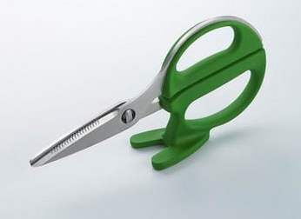
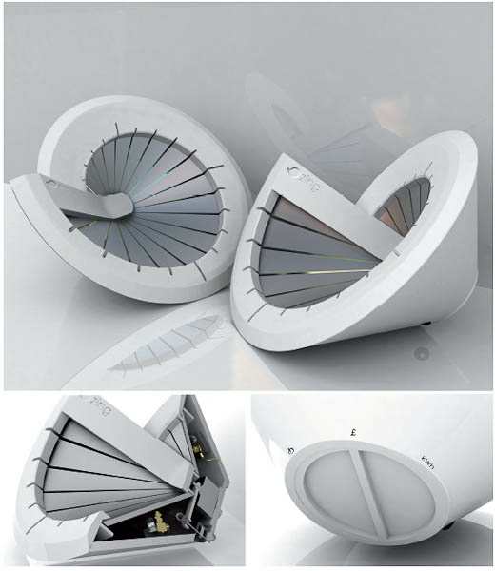
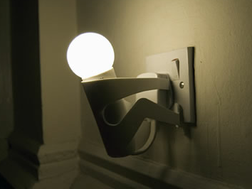

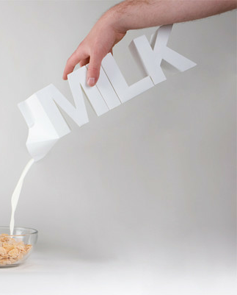
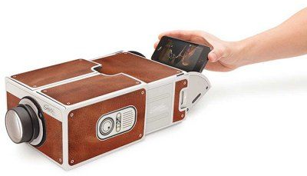
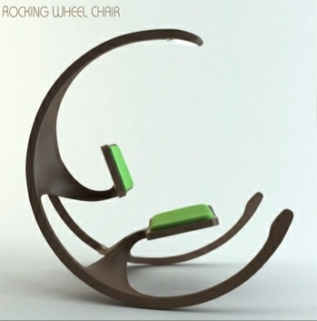
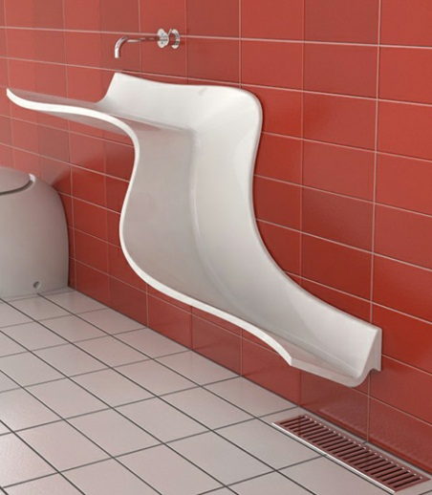
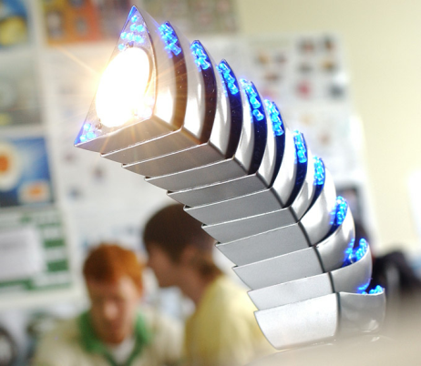
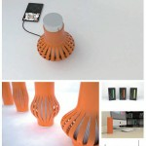
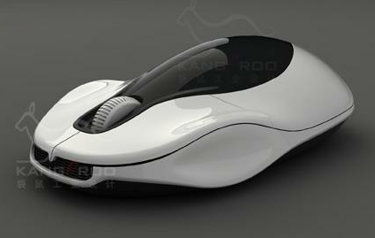
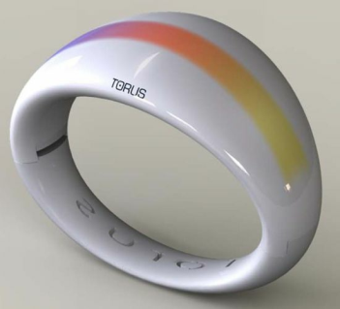
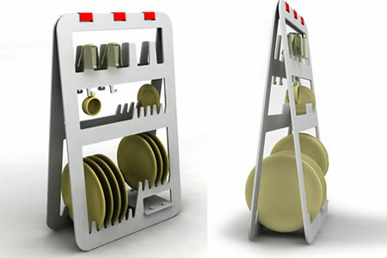
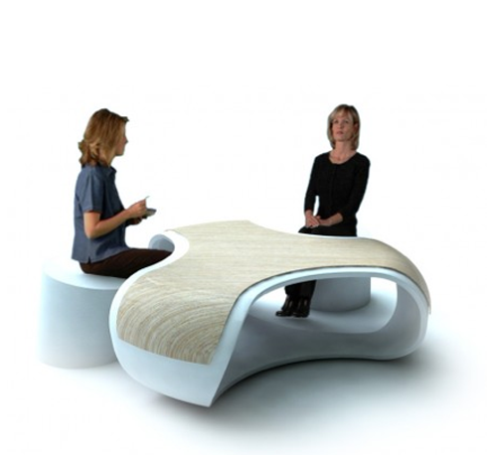
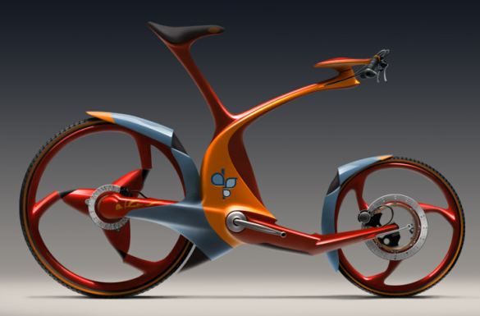
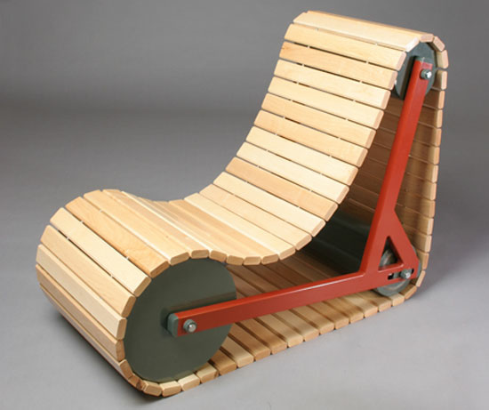
DESIGN
iGCSE Design Technology Introduction
Notes:
Demonstration of pewter casting
- Features of moulds & potential issues
- Demonstration of hand made mould to
pewter casting
- Student create practice mould using hand
tools and cast.

Slide 2
Helping Hand - Design
Learning Objectives
Learn to think creatively
Learn to set criteria / specification for a design
Communicate Design ideas
Present a design concept
DESIGN

Slide 3
Helping Hand - Design
Cover Lesson 2 Tasks
Complete all unfinished tasks from last lesson (MAX 20 minutes)
Take out your table drawing from lesson 1
Think Pair Share: What are these?
Overview: Table Re-Design Task:
Set criteria for your table re-design
Produce a series of sketches to show your design ideas for the table re-design.
Extension: Present your Re-Design in a one page design sheet with initial sketches, design criteria and final product visualisation (Gemini)
DESIGN

Slide 4
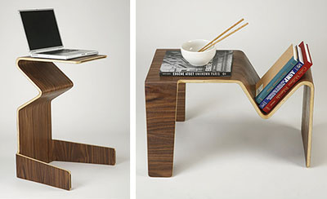
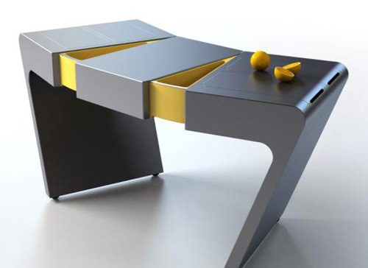
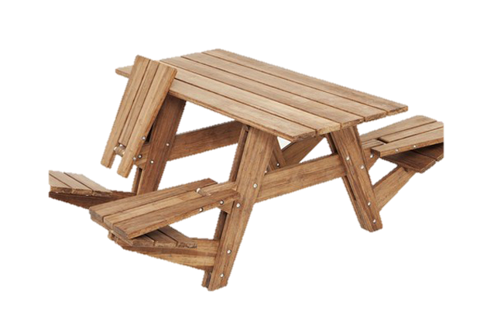
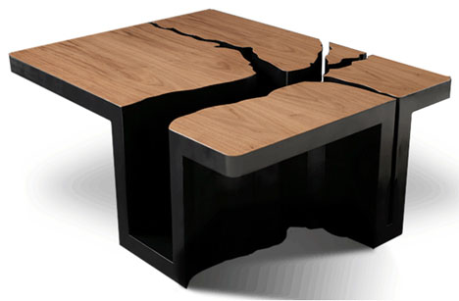
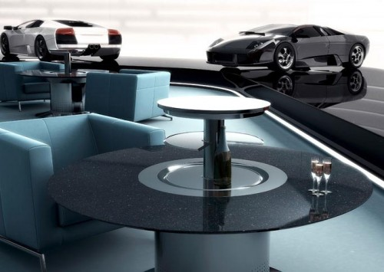
IGCSE Design Technology
Rethink - 3D Table?
DESIGN

Slide 5
IGCSE Design Technology
Table Redesign
Now look at your first table drawing.
Is it creative? Do tables have to have a set number of legs or be a set shape?
Task.
Now re-design your table trying to be more creative. First you need to think of a user, theme, or environment (place) it will go in.
DESIGN

Slide 6
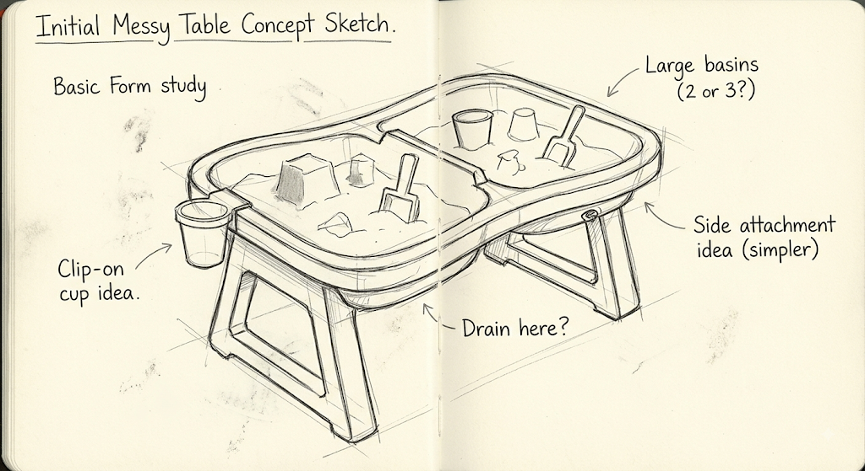
IGCSE Design Technology
EXAMPLE
Table Redesign
Task.
Re-design your table by first defining the following criteria:
User / Target Audience
Main Function
Environment where it is used
Approximate Size
Aesthetics (must be desirable to your user!)
Material suggestions
DESIGN
3-6 year olds kindergarten children
Height max 5o cm and 60x80 cm footprint
Plastic (water proof and light-weight)
Colourful and cheerful, primary colours, rounded corners for added safety
Can be used indoor and outdoors
Messy-play, sand play

Slide 7
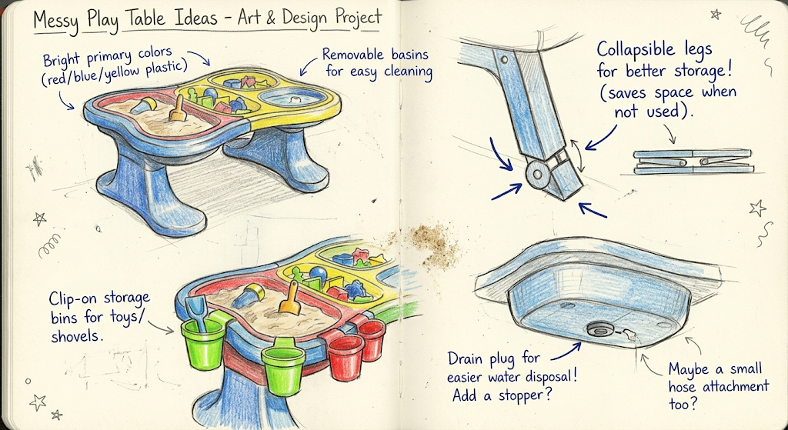
IGCSE Design Technology
Table Redesign - Idea Development
Task.
Develop your idea by creating a series of sketches to show details
Render your sketches
Annotate
Present your sketches
DESIGN

Slide 8

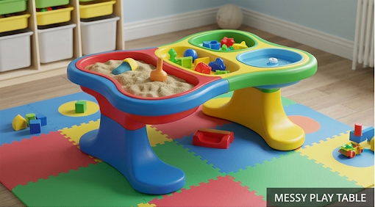

Helping Hand - Design
Critical Thinking Skills
Think-Pair-Share
How could you present this to a higher standard?
DESIGN
Is this cheating?
Keywords
Photo-realistic
Colourful
Plastic
Child room
play mat
Child size
Primary colours
What prompt would you use?

Slide 9


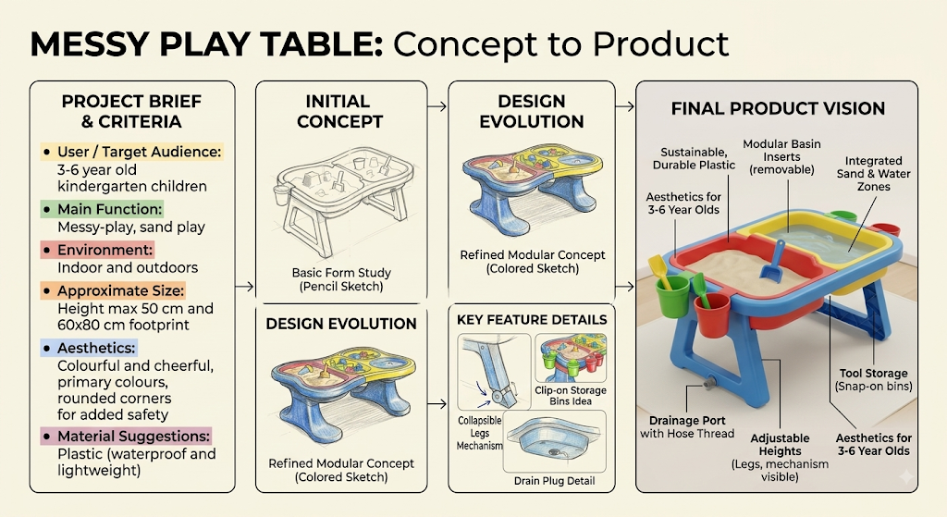
Helping Hand - Design
Creativity Skills
Extension
Communication Skills
Present your Design Process
DESIGN
Keywords
Clean layout
Annotations
Visual Flow
Cropped images
Clean image scans

